Slide 1
How to Cook a Fox
with Chef
Claus Niesen
April 6th
Story County Amateur Radio Club
KE0LMQ

Slide 2
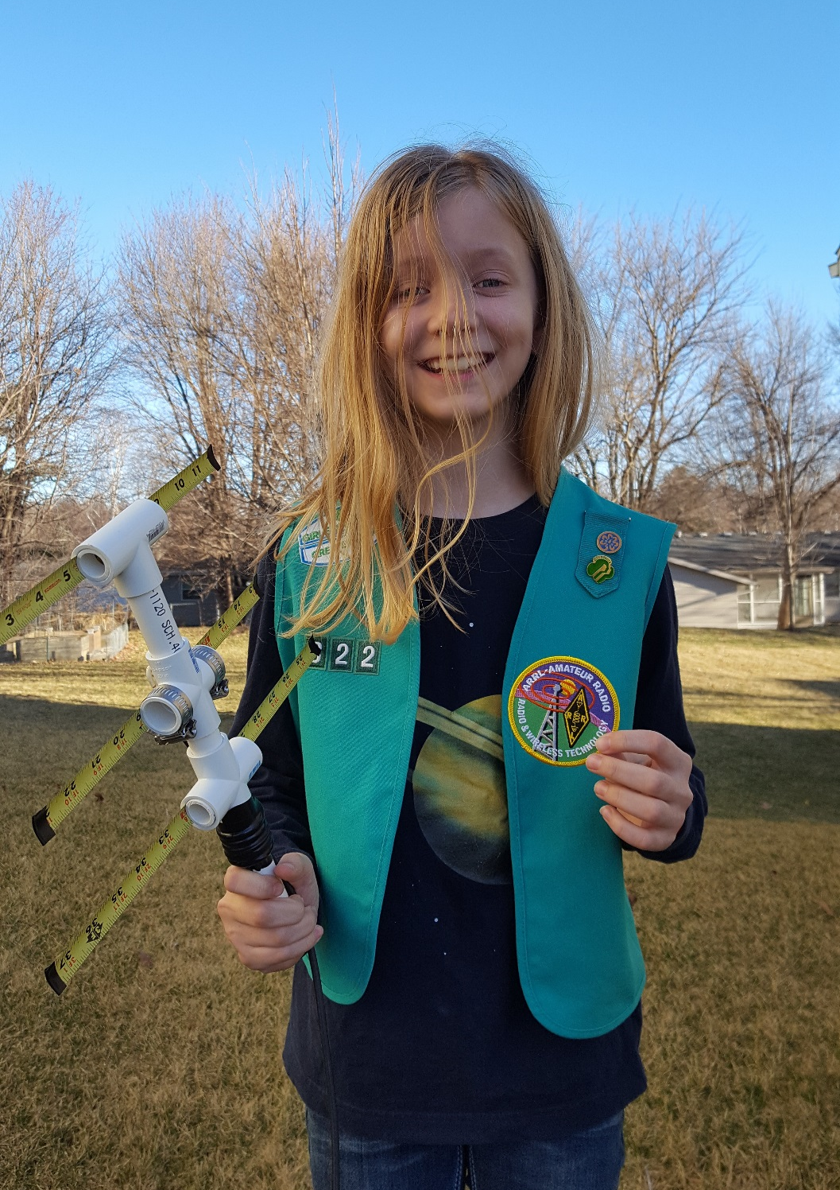
Notes:
History: Heidi’s foxhunt with Clint for the ARRL Girl Scout Patch

Slide 3
Notes:
History: Getting the idea to build a fox.

Slide 4
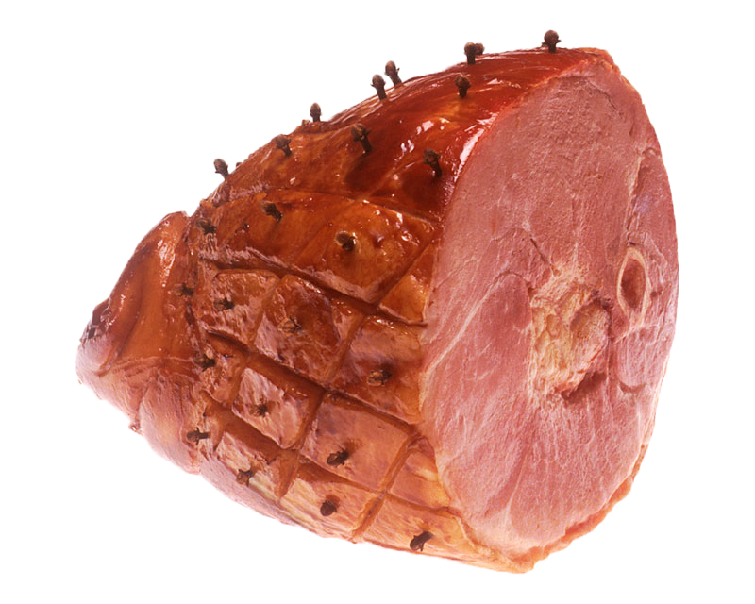
Ingredients:
+
Notes:
The Idea: Raspberry Pi wired to a BaoFeng radio.

Slide 5
The Pi
e
Transmit voice signal:
Transmit voice signal:
Python script
Python script
Text-to-Speech
Text-to-Speech
GPIO for PTT
Notes:
The software side.

Slide 6
Demo
Notes:
Raspberry Pi: Run fox program using speaker only.
ssh pi@100.100.100.1 python fox

Slide 7
The Interface
Isolate Audio
Isolate Audio
Isolate PTT
Isolate PTT
Notes:
The hardware side

Slide 8
BaoFeng Wiring
Notes:
The hardware side

Slide 9
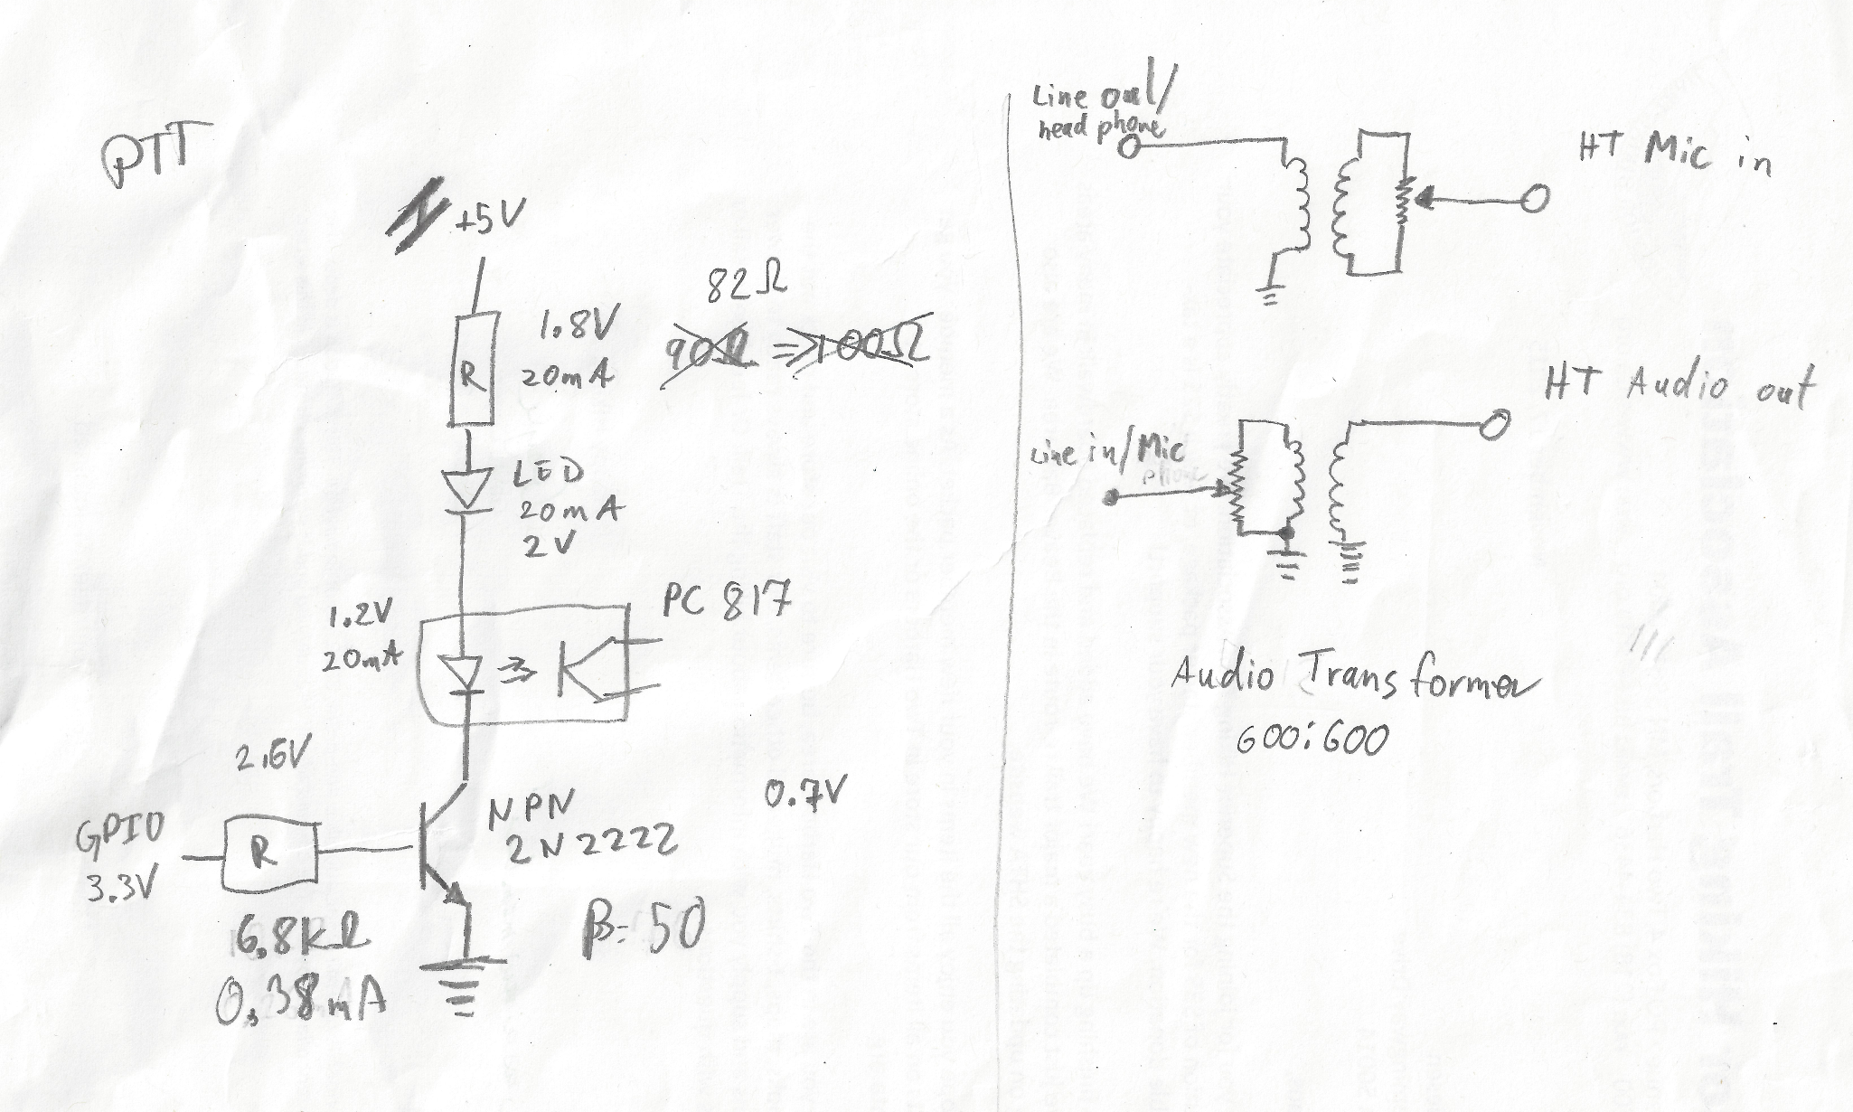
Circuit Diagram
Notes:
The hardware side

Slide 10
Project Board Exploration
Notes:
The hardware side

Slide 11
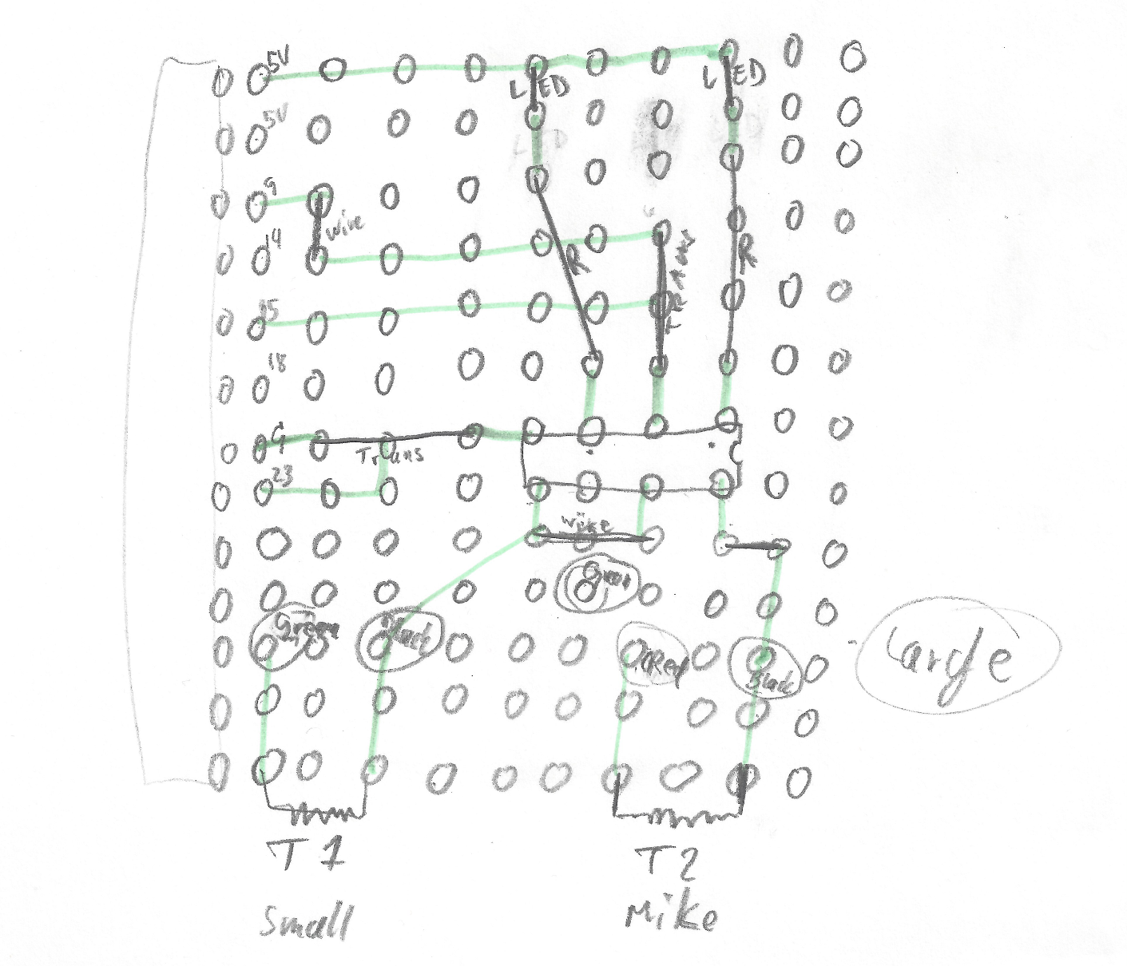
Project Board Layout
Notes:
The hardware side

Slide 12
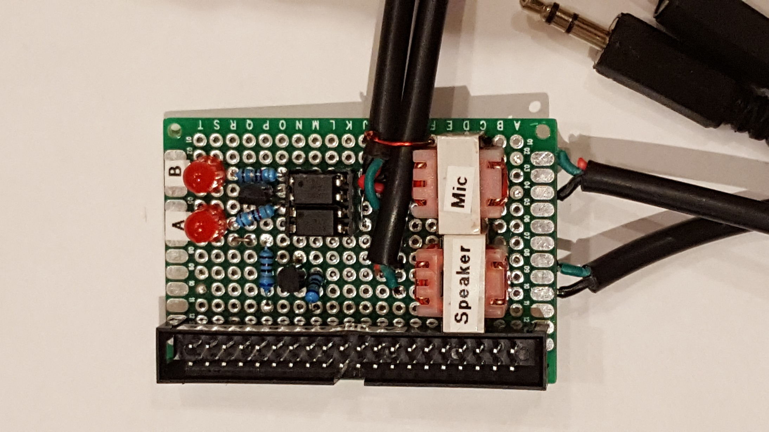
Demo
Notes:
Raspberry Pi + HT: Run test transmission.
Python demo

Slide 13
Future Ideas
Use Audio Jacks
Use Audio Jacks
Listen for activity before Transmission
Listen for activity before Transmission
Log Finds (RFID)
Log Finds (RFID)
Use for Digital Communication

Slide 14
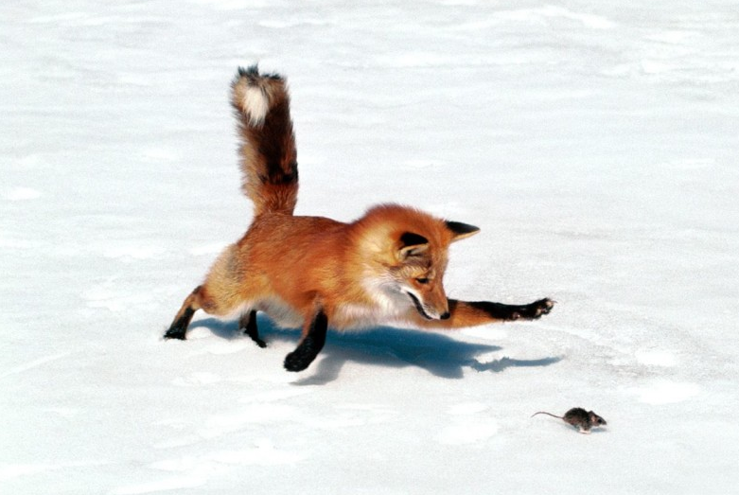
Let the Hunt Begin
Claus Niesen
KE0LMQ
claus@niesens.com

